Slide 1
Risk Management

Slide 2
Chapter Objectives
Describe the project risk management planning framework introduced in this chapter.
Define risk identification and the causes, effects, and integrative nature of project risks.
Apply several qualitative and quantitative analysis techniques that can be used to prioritize and analyze various project risks.
Describe the various risk strategies, such as insurance, avoidance, or mitigation.
Describe risk monitoring and control.
Describe risk evaluation in terms of how the entire risk management process should be evaluated in order to learn from experience and to identify best practices.

Slide 3
Some Common Mistakes
Benefits of risk management are not well-understood
  Just do it!
Not providing adequate time for risk management
  Should be part of the ITPM
Not identifying and assessing risk using a standardized approach
  Miss threats & opportunities
Crisis management (i.e. firefighting) is “reactive”
  Risk management is “proactive”
  Cheaper & less embarrassing than crisis management

Slide 4
Effective and Successful Project Risk Management Requires:
Commitment by all stakeholders
Stakeholder Responsibility
  each risk must have an owner
Different risks for different types of projects
  attempting to manage all projects and risks the same way may spell disaster

Slide 5
PMBOK® Definitions
Risk
  An uncertain event or condition that, if it occurs, has a positive or negative effect on the project objectives.
Risk Management
  The systematic process of identifying, analyzing, and responding to project risk. It includes maximizing the probability and consequences of positive events and minimizing the probability and consequences of adverse events.

Slide 6
Broad Categories of Risk
  Market risk – Will the new service or product be useful to the organization or marketable to others? Will the users accept it? Will someone else create a better product?
  Financial risk – can the organization afford to undertake the project? Will the project meet NPV, ROI and payback estimates?
  Technology risk – is the project technically feasible? Is it leading edge or bleeding edge technology?
  People risk – Are people with appropriate skills available to help complete the project? Does senior management support the project?
  Structure/process risk – What is the degree of change the new project will introduce into user areas and business procedures? With how many other systems does a new project/system need to interact?

Slide 7
Example - What Went Wrong?
KPMG, a large consulting firm, published a study in 1995 found that 55 percent of runaway projects—projects that have significant cost or schedule overruns—did no risk management at all; 38 percent did some (but half did not use their risk findings after the project was underway); and 7 percent did not know whether they did risk management or not
The timing of risk management is also an important consideration
  Comair delayed replacing a legacy system that managed flight crews and, when it eventually crashed over the holidays, 3,900 flights were cancelled, 200,000 passengers were stranded and ran up a tab of $20 million.

Slide 8
Risk Breakdown Structure
A risk breakdown structure is a hierarchy of potential risk categories for a project
Similar to a work breakdown structure but used to identify and categorize risks
In addition to identifying risk based on the nature of the project or products produced, it is also important to identify potential risks according to project management knowledge areas

Slide 9
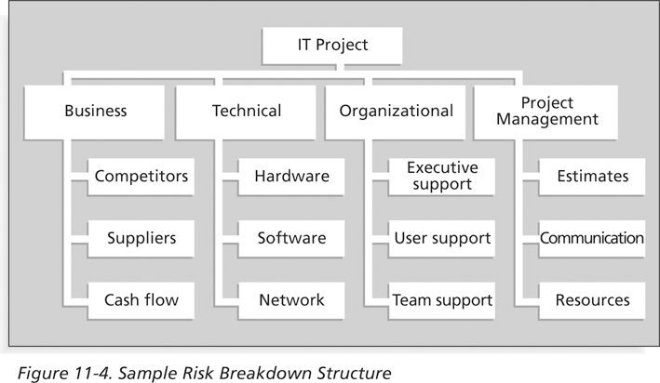
Sample Risk Breakdown Structure

Slide 10
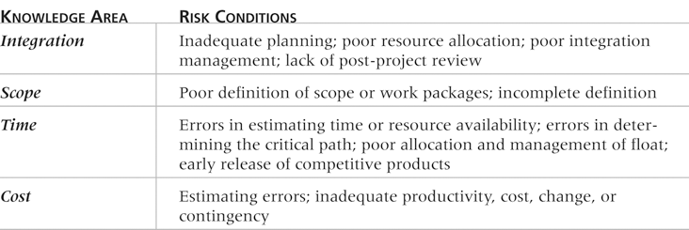
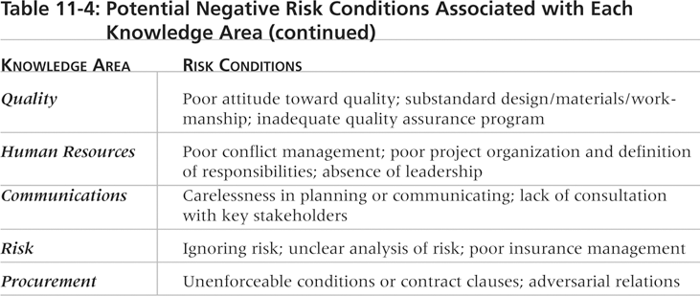
Potential Negative Risk Conditions Associated With Each Knowledge Area

Slide 11
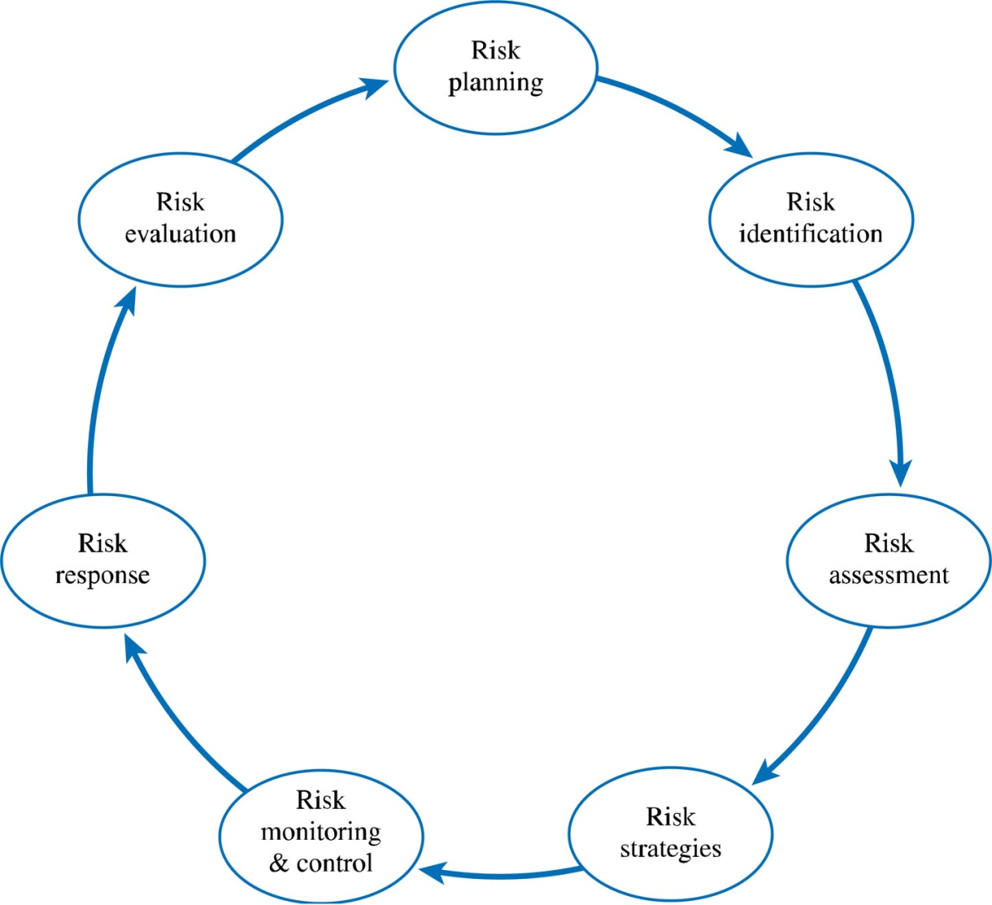
IT Project Risk Management Processes
Figure 8.1

Slide 12
IT Project Risk Management Planning Process
Risk Planning
  Requires a firm commitment to risk management from all project stakeholders
  Ensures adequate resources to plan for and manage risk
  Focuses on preparation – resources, processes and tools be in place to plan for project risk management.

Slide 13
IT Project Risk Management Planning Process
Risk Identification
  Identify potential risks that can impact the project
    Includes both threats and opportunities
  Should include many of the project stakeholders
  The IT Project Risk Framework provides a tool for understanding the timing and interrelatedness of IT project risks

Slide 14
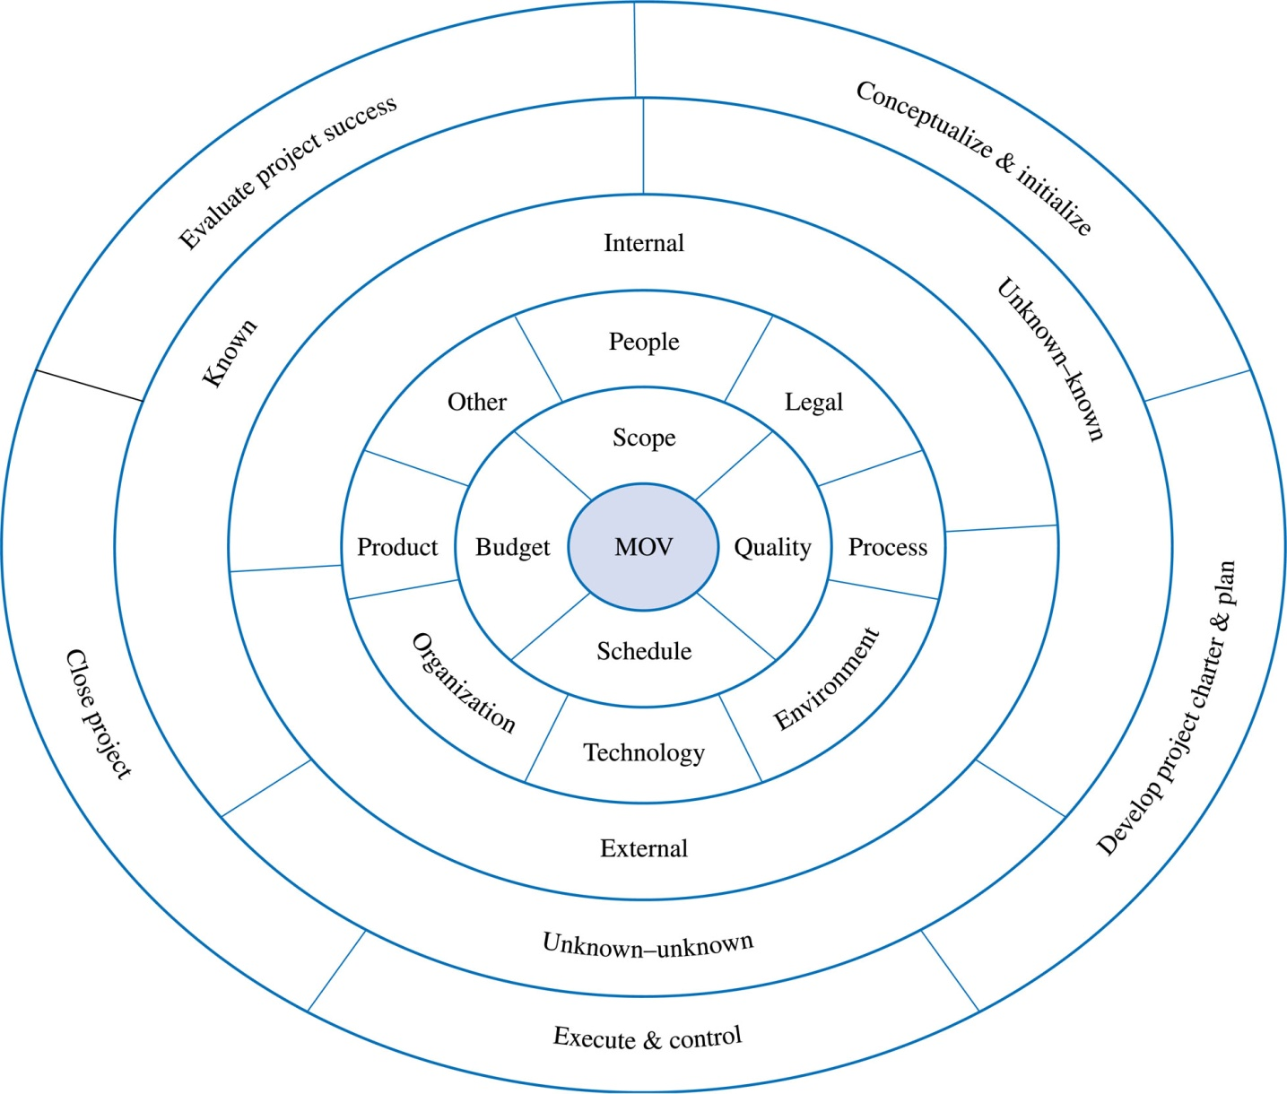
IT Project Risk Management Framework
Figure 8.2

Slide 15
IT Project Risk Management Framework
Layer 1/ Core: MOV (Measurable Organisational Value)
Layer 2: the project objectives in terms of scope, quality, schedule and budget
Layer 3: Sources of IT project risk
Layer 4: Are the sources of risk internal or external to the project? The distinction not always clear. Which ones are under direct control of the project manager?
Layer 5: Three different types of risks:
  Known risks – events that will certainly occur
  Known – unknown –identifiable uncertainity eg amount of bill for utilities
  Unknown-unknown – events you can not imagine happening – identified after they occur
Layer 5: Time element in terms of the project life cycle

Slide 16
Risk Management: Tools For Identifying IT Project Risks
Learning Cycles
Brainstorming
Nominal Group Technique
Delphi Technique
Checklists
SWOT Analysis
Cause & Effect (a.k.a. Fishbone/Ishikawa)
Past Projects

Slide 17
Identifying IT Project Risks: Learning cycles
Project team and stakeholders identify facts (what they know), assumptions (what they think they know) and research (things to find out)
Create an action plan based on the three categories, to test assumptions and conduct research about various risks
Document both risks and lessons learned, based on the findings

Slide 18
Identifying IT Project Risks:
Brainstorming
Brainstorming is a technique by which a group attempts to generate ideas or find a solution for a specific problem by amassing ideas spontaneously and without judgment
An experienced facilitator should run the brainstorming session
Be careful not to overuse or misuse brainstorming
  Psychology literature shows that individuals produce a greater number of ideas working alone than they do through brainstorming in small, face-to-face groups
  Group effects often inhibit idea generation

Slide 19
Identifying IT Project Risks
Nominal Group Technique (NGT)
  Each individual silently writes her or his ideas on a piece of paper
  Each idea is then written on a board or flip chart one at a time in a round-robin fashion until each individual has listed all of his or her ideas.
  The group then discusses and clarifies each of the ideas.
  Each individual then silently ranks and prioritizes the ideas.
  The group then discusses the rankings and priorities of the ideas.
  Each individual ranks and prioritizes the ideas again.
  The rankings and prioritizations are then summarized for the group.

Slide 20
Identifying IT Project Risks: Delphi Technique
The Delphi Technique is used to derive a consensus among a panel of experts who make predictions about future developments
  Developed by the RAND Corporation for the US Air Force in the late 1960s
The experts do not ever have to meet face to face
Provides independent and anonymous input regarding future events
Uses repeated rounds of questioning and written responses and avoids the biasing effects possible in oral methods, such as brainstorming
  The experts are asked to identify potential risks or discuss the impact of a particular risk, responses collected and made available anonymously to each other, evaluated in the second round and the process continues until a consensus exists

Slide 21
Identifying IT Project Risks - Checklists
Example of a Risk Check List
Funding for the project has been secured
Funding for the project is sufficient
Funding for the project has been approved by senior management
The project team has the requisite skills to complete the project
The project has adequate manpower to complete the project
The project charter and project plan have been approved by senior management or the project sponsor
The project’s goal is realistic and achievable
The project’s schedule is realistic and achievable
The project’s scope has been clearly defined
Processes for scope changes have been clearly defined

Slide 22

Identifying IT Project Risks: SWOT Analysis

Slide 23
Identifying IT Project Risks: Cause and Effect Diagram
Identify the risk in terms of a threat or opportunity.
Identify the main factors that can cause the risk to occur.
Identify detailed factors for each of the main factors.
Continue refining the diagram until satisfied that the diagram is complete.

Slide 24
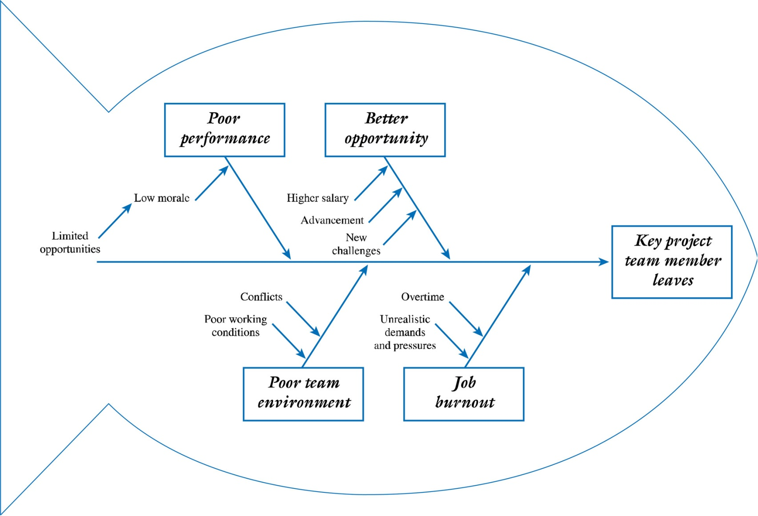
Cause and Effect Diagram

Slide 25
Past Projects
Lessons learned from past projects can provide insight and best practices for identifying and understanding the nature of IT project risks
  Develop a base of knowledge from past projects

Slide 26
Risk Register
The main output of the risk identification process is a list of identified risks and other information needed to begin creating a risk register
A risk register is:
  A document that contains the results of various risk management processes and that is often displayed in a table or spreadsheet format
  A tool for documenting potential risk events and related information
Risk events refer to specific, uncertain events that may occur to the detriment or enhancement of the project
  Negative risks: delays in completing work as scheduled, increases in estimated costs, supply shortages, litigation, strikes, etc.
  Positive risks: completing work sooner and/or cheaper than planned, collaborating with suppliers to produce better products, good publicity, etc.

Slide 27
Risk Register Contents
An identification number for each risk event
A rank for each risk event
The name of each risk event
A description of each risk event
The category under which each risk event falls
The root cause of each risk
Triggers for each risk; triggers are indicators or symptoms of actual risk events
  Cost overruns on early activities, defective products
Potential responses to each risk
The risk owner or person who will own or take responsibility for each risk
The probability and impact of each risk occurring
The status of each risk

Slide 28
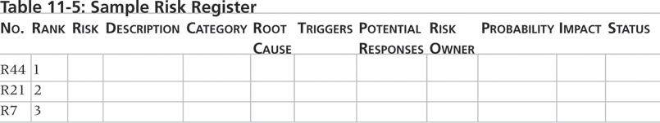
Sample Risk Register

Slide 29
IT Project Risk Management Planning Process: Risk Analysis and Assessment
Determines what opportunities and threats should be addressed
Risk Analysis
  Risk = f(Probability * Impact)
    What is the probability of a particular risk occurring?
    What is the impact on the project if it does occur?
Risk Assessment
  Focuses on prioritizing risks so that an effective strategy can be formulated for those risks that require a response.
    Depends on Stakeholder risk tolerances
    You can’t respond to all risks!

Slide 30
Risk Analysis and Assessment Tools
Qualitative Approaches – includes subjective assessments based on experience or intuition
  Expected Value
  Payoff Table
  Decision Trees
  Risk Impact Table
  Tusler’s risk classification scheme
Quantitative Approaches – based on mathematical and statistical techniques
  Probability Distributions
    Discrete
      Binomial
    Continuous
      Normal
      PERT
      Triangular
  Simulations

Slide 31
Expected Value
Is an average, or mean, that takes into account both the probability and impact of various events or outcome
Eg, assume a project manager wanting to determine the expected payoff associated with several possible outcomes or events. His subjective beliefs are summarised in a payoff table (next slide)
The payoff for finishing the project early is quite high, while there is a penalty for completing the project late.
- Since each event is mutually exclusive (i.e only one of the five events can occur), the probabilities must sum up to 100 percent

Slide 32
Expected Value of a Payoff Table
Schedule Risk | A Probability | B Payoff (in 000s) | A * B Prob. * Payoff
Project completed 20 days early | 5% | $200 | $10
Project completed 10 days early | 20% | $150 | $30
Project completed on schedule | 50% | $100 | $50
Project completed 10 days late | 20% | $ -- | $ --
Project completed 20 days late | 5% | $ (50) | $ (3)
 | 100% |  | $88 Expected Value

Slide 33
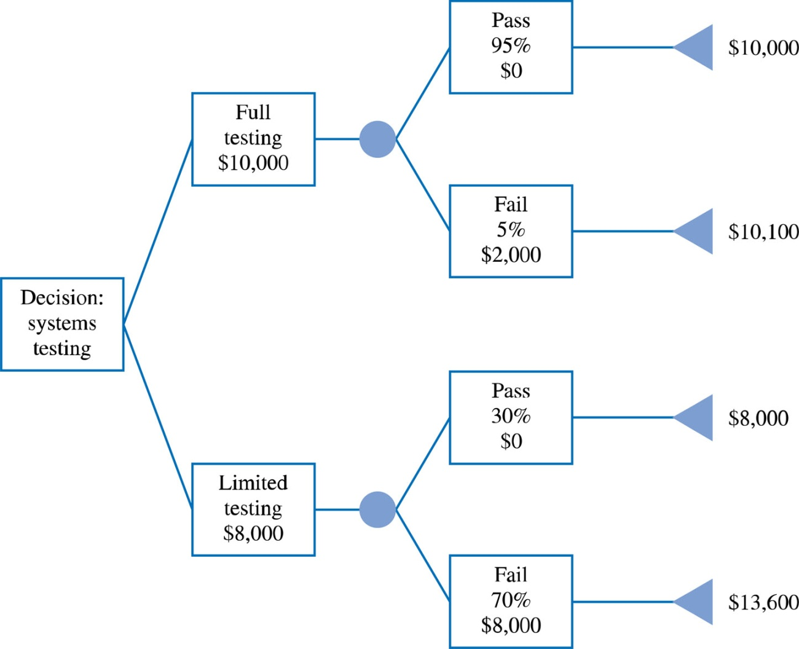
Decision Tree Analysis
Figure 8.5

Slide 34
Risk Impact Table
0 - 100%
0-10
P*I
Risk (Threats)
Probability
Impact
Score
Key project team member leaves project
40%
4
1.6
Client unable to define scope and requirements
50%
6
3.0
Client experiences financial problems
10%
9
0.9
Response time not acceptable to users/client
80%
6
4.8
Technology does not integrate with existing application
60%
7
4.2
Functional manager deflects resources away from project
20%
3
0.6
Client unable to obtain licensing agreements
5%
7
0.4

Slide 35
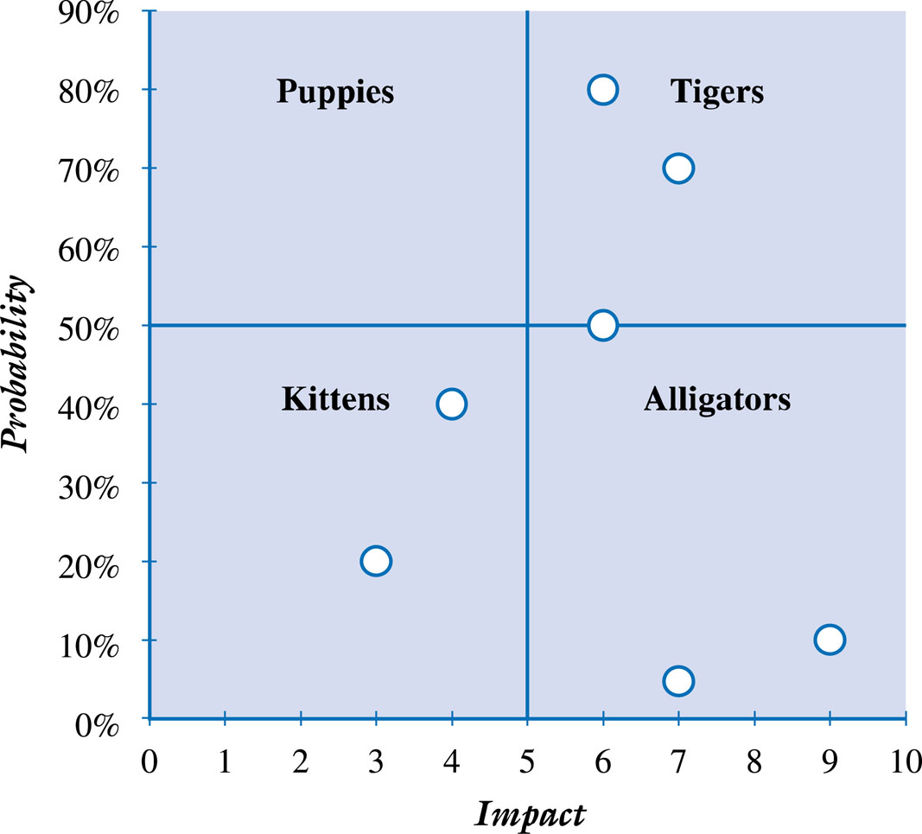
Tusler’s Risk Classification Scheme - Further analysis of the risks
Figure 8.6

Slide 36
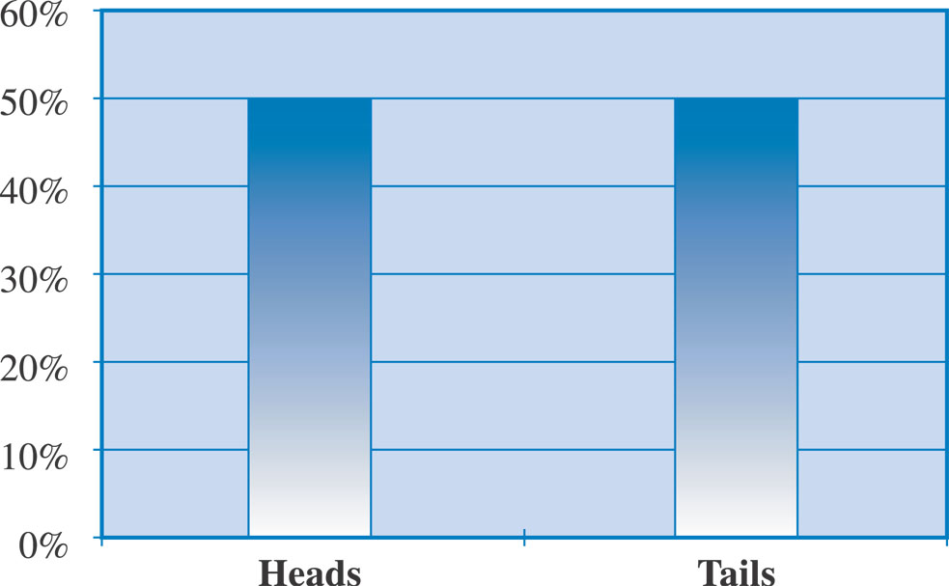
Quantitative approaches: Discrete probability distributions
Are mutually exclusive and exhaustive – one and only one of these events may occur e.g. the tossing of a coin

Slide 37
Continuous probability distributions - Normal Distribution
Useful for developing risk analysis models when an event has an infinite number of possible values within a stated range
Shape is determined by its mean (µ) and standard deviation (σ)
Probability is associated with area under the curve.
Since the distribution is symmetrical, the following probability rules of thumb apply
  About 68 percent of all the values will fall between +1 σ of the mean
  About 95 percent of all the values will fall between +2 σ of the mean
  About 99 percent of all the values will fall between +3 σ of the mean

Slide 38
Continuous probability distributions – Normal distribution
Assume the probability of a risk event follows a normal distribution. An outcome can be predicted with some confidence .
Example: Assume a project with a mean duration of 10 days, and std deviation of 2 days, established over time.
Using the rules of the thumb described, we could estimate, for example, that we would be about 95% certain that the project’s task would be complete within 6 to 14 days (μ + 2σ = 10 + 2x2 ).
We could be about 97% confident that the task would be completed between four and sixteen days
(μ + 3σ = 10 + 3x2 ).

Slide 39
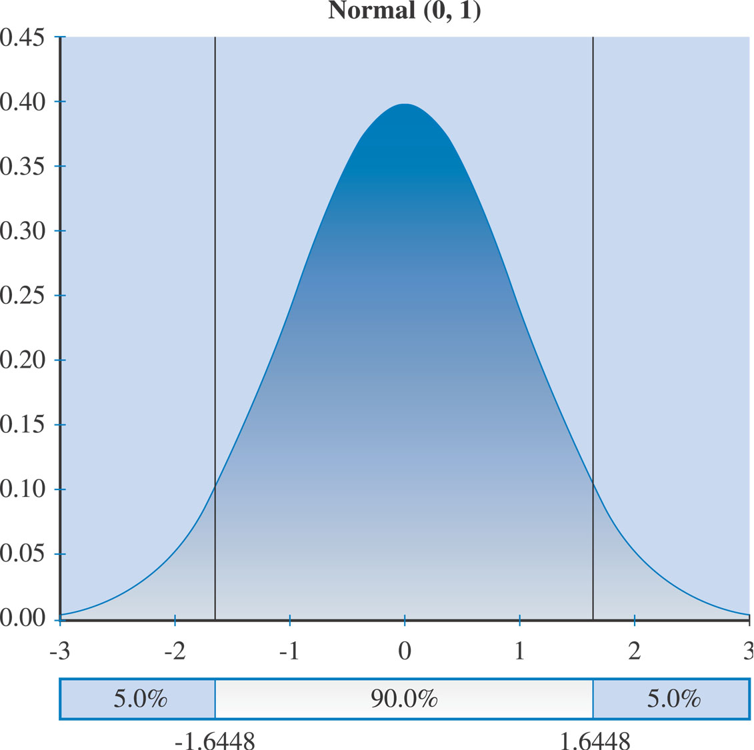
Example Normal Distribution

Slide 40
PERT Distribution
PERT distribution uses a three-point estimate where:
  a denotes an optimistic estimate
  m denotes a most likely estimate
  b denotes a pessimistic estimate
PERT Mean = (a + 4m + b) / 6
PERT Standard Deviation = (b - a) / 6

Slide 41
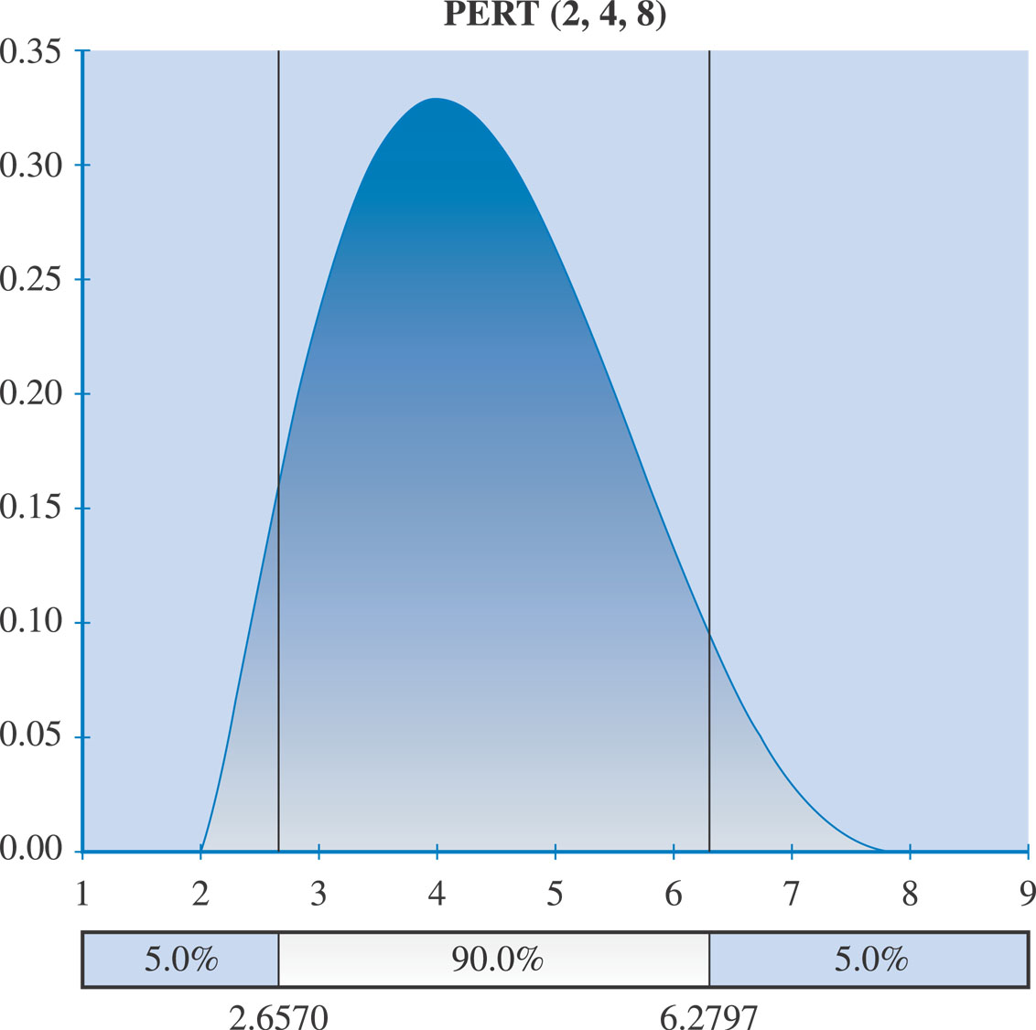
PERT Distribution

Slide 42
Triangular Distribution
uses a three-point estimate similar to the PERT distribution where:
  a denotes an optimistic estimate
  b denotes a most likely estimate
  c denotes a pessimistic estimate
weighting for the mean and standard deviation are different from PERT
  TRIANG Mean = (a + m + b) / 3
  TRIANG Standard Deviation =
    [((b-a)² + (m-a)(m-b)) /18]^{1/2}

Slide 43
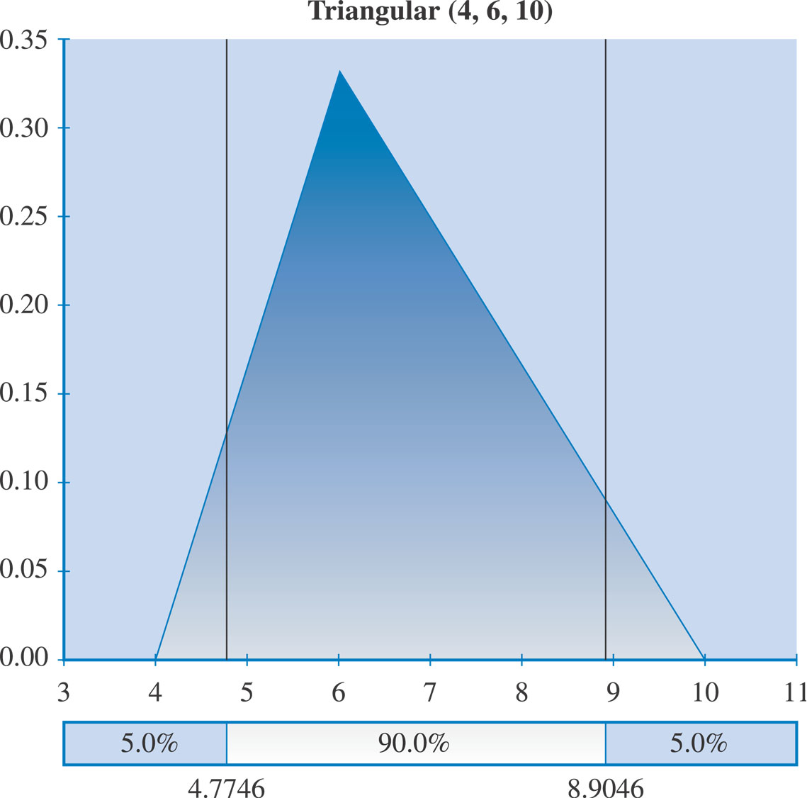
Triangular Distribution

Slide 44
Simulations
Simulation uses a representation or model of a system to analyze the expected behavior or performance of the system
  To use a Monte Carlo simulation, you must have three estimates (most likely, pessimistic, and optimistic) plus an estimate of the likelihood of the estimate being between the most likely and optimistic values
Monte Carlo analysis simulates a model’s outcome many times to provide a statistical distribution of the calculated results
  Predicts the probability of finishing by a certain date or that the cost will be equal to or less than a certain value

Slide 45
Sensitivity Analysis
Sensitivity analysis is a technique used to show the effects of changing one or more variables on an outcome
For example, many people use it to determine what the monthly payments for a loan will be given different interest rates or periods of the loan, or for determining break-even points based on different assumptions
Spreadsheet software, such as Excel, is a common tool for performing sensitivity analysis

Slide 46
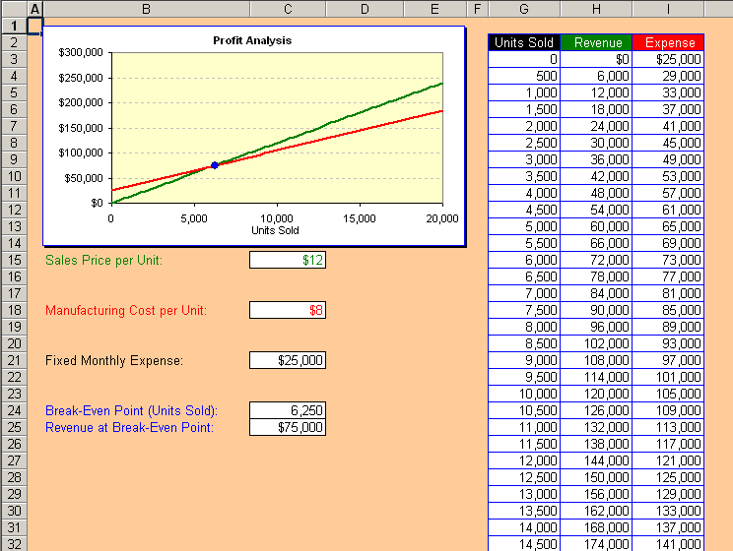
Sample Sensitivity Analysis for Determining Break-Even Point

Slide 47
IT Project Risk Management Planning Process: Risk Strategies
Depends On:
  The nature of the risk itself
    Really a threat or an opportunity? How will the project be affected? And at what points? Triggers?
  The impact of the risk on the project’s measurable organisational value (MOV) and objectives
    What is the probability and impact of a risk?
  The project’s constraints in terms of scope, schedule, budget, and quality
    Can a response be made with existing resources and/or constraints? Will additional resources be availed if a particular risk occurs? What will happen if the desired result is not achieved?
  Risk Tolerances or preferences of the project stakeholders
    Is a risk for one stakeholder a risk for another? How much risk is tolerable? How committed is each stakeholder to risk management? Is the potential reward worth the effort?

Slide 48
IT Project Risk Management Planning Process
Risk Strategies
  Accept or ignore the risk
    Management Reserves
    Contingency Reserves
    Contingency Plans
  Avoid the risk completely.
  Mitigate / reduce the likelihood or impact of the risk (or both) if the risk occurs.
  Transfer the risk to someone else (i.e., insurance).

Slide 49
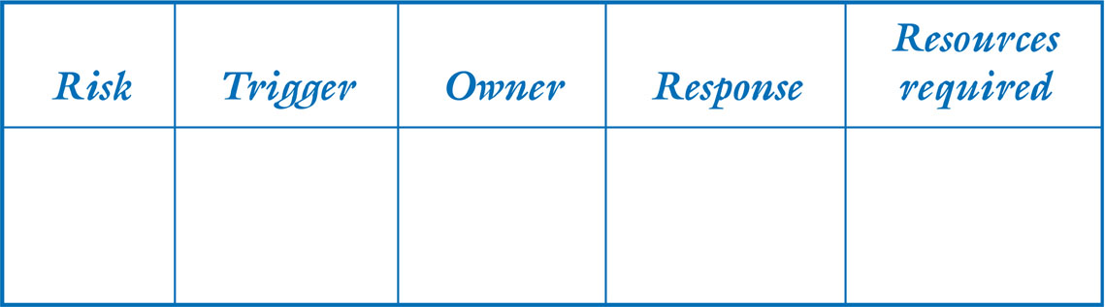
Risk Response Plan
Documents the project risk and strategies
Should include:
The project risk
The trigger which flags that the risk has occurred
The owner of the risk (i.e., the person or group responsible for monitoring the risk and ensuring that the appropriate risk response is carried out)
A risk response based on one of the four basic risk strategies
Figure 8.15

Slide 50
IT Project Risk Management Planning Process
Risk Monitoring and Control
Risk Response
Risk Evaluation
  How did we do?
  What can we do better next time?
  What lessons did we learn?
  What best practices can be incorporated in the risk management process?

Slide 51
Risk Monitoring and Control
Involves continually monitoring the various risk triggers to keep track of the risks
Focuses on metrics to help identify when a risk occurs, and communication
Tools for monitoring and controlling project risk
  Risk Audits by external people – provides a fresh perspective
  Risk Reviews by internal team members – hold scheduled, periodic risk reviews – should be part of each team meeting and the team’s learning cycles
  Risk Status Meetings and Reports – formal communication system

Slide 52
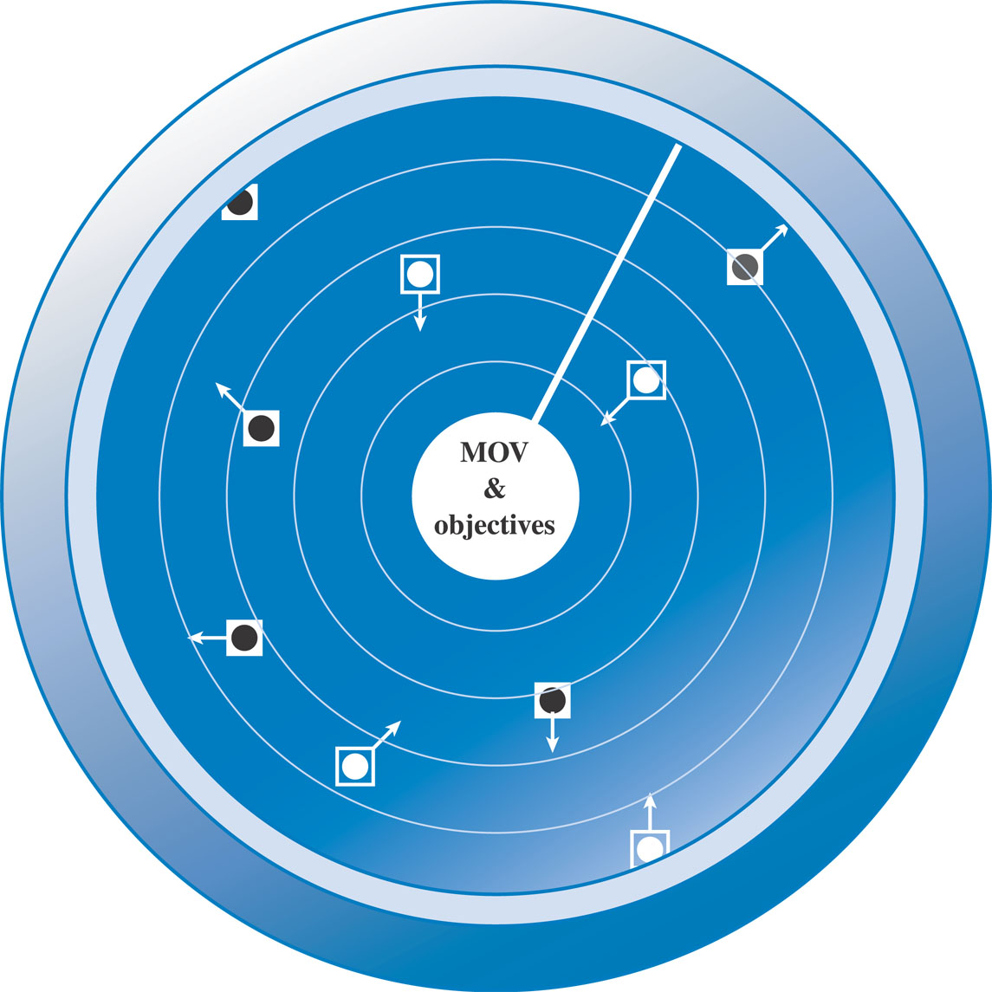
Project Risk Radar
Monitoring project
risks is analogous
to a radar scope
where threat and
opportunities may
present themselves
at different times
Figure 8.16

Slide 53
Risk Response and Evaluation
When a trigger occurs, appropriate action as outlined in the risk response plan should be taken
Adequate resources must be available and used to respond to the risk
Outcome can be favorable or unfavorable
Lessons learned and best practices in the entire process of risk management would help us to:
  Increase our understanding of IT project risk in general.
  Understand what information was available to managing risks and for making risk-related decisions.
  Understand how and why a particular decision was made.
  Understand the implications not only of the risks but also the decisions that were made.
  Learn from our experience so that others may not have to repeat our mistakes.

Slide 54
Exercise
The LASCAD case is an IT project that failed. Using the IT project risk framework, identify the explicit or implicit risks that may have impacted this project.

